Slide 1
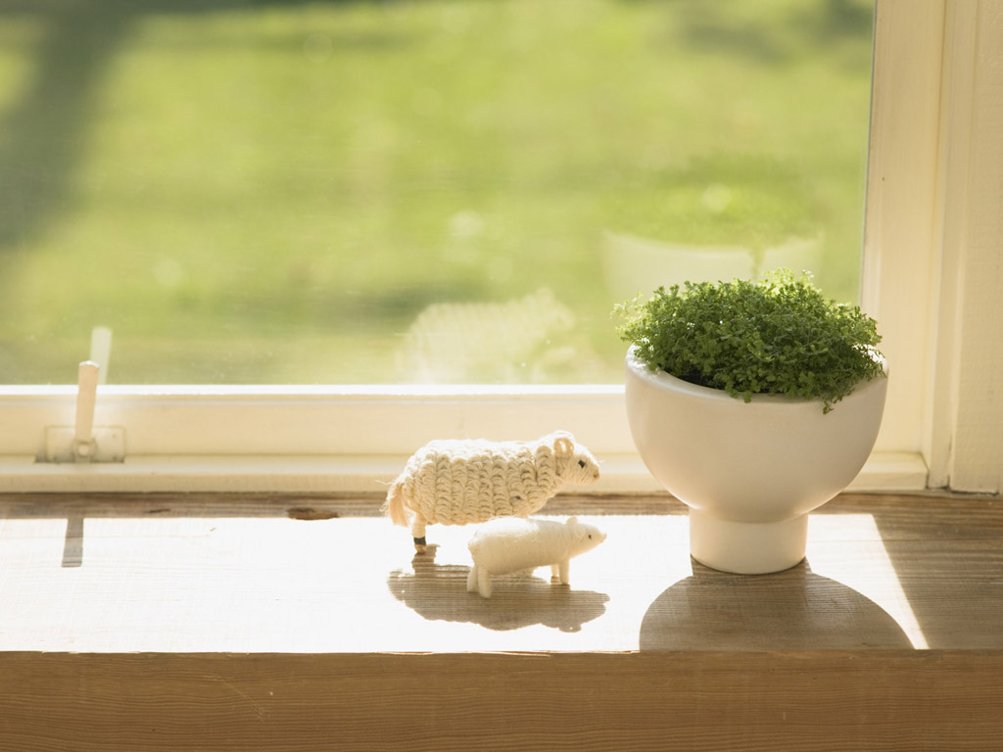
平安豆花
組員：吳盈緯、廖家偉
指導老師：蔡麗雀

Slide 3
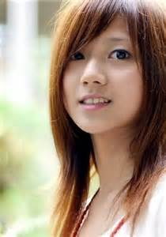
豆花妹
?

Slide 4
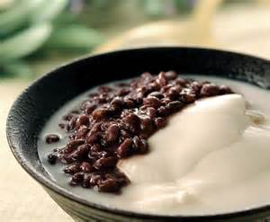
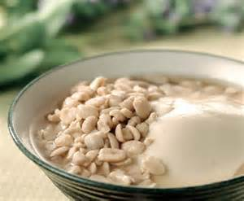
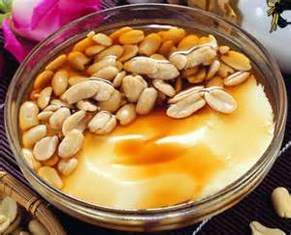
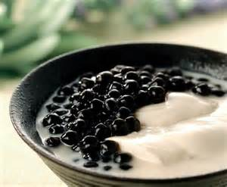
Douhua
Bean curd, bean curd full name, also known as bean curd or frozen Is formed from yellow milk solidified Chinese food

Slide 5
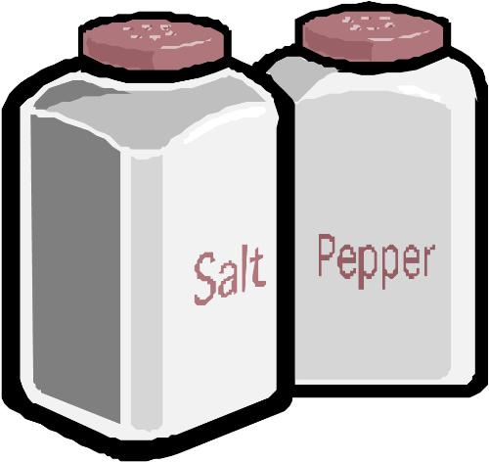
Prepare materials
Douhua the material：
Soybean 300 grams (Please use a non-genetically modified soybeans), 10 bowls of water (about 2200cc), tofu plaster 5-7 grams
40 grams of sweet potato flour
half a bowl of cold water
the material Tong Shui ：
Sugar bowl, 5 bowls of water
ginger 6

Slide 6
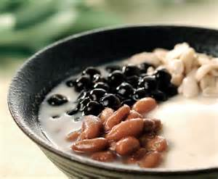
Douhua practice
1. Soybean soak overnight first, then Soybean and 10 times with the blender bowl of water smashed after breaking boil then filtered dregs, it becomes soymilk
2. Take a width of 30 cm diameter and a height of about 30 cm above the round pot into tofu plaster, sweet potato powder, stir together the bowl of water
3. The filtered good soymilk from a height Round down into the pot, then stir to forgo Mix until 10 minutes into the Douhua after
coagulation The top of the foam can be
scraped off with a spoon
4. Tong Shui production: just all Tong Shui Material together boil. Can also be used Bean soup or bean soup, and so on Tong
Shui substitute

Slide 7
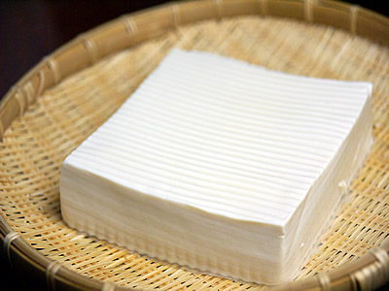
Tofu practice
The Douhua wrapped with cotton flat top with heavy objects up to dehydration forming, after a period of time to become tofu, soaked with cold
water in the refrigerator
you can save on the
number of days

Slide 8
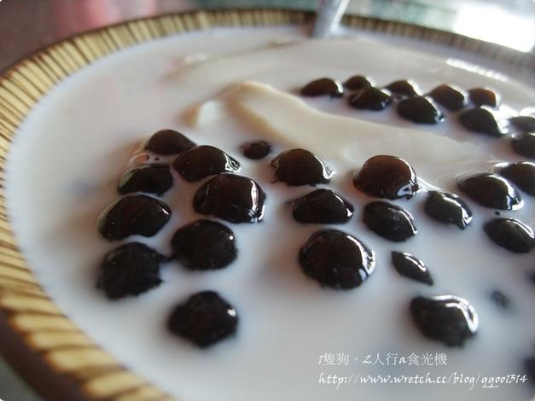
Self-made traditional Douhua
There are three practice Douhua：
(1). With bean pollen, which is readily available powder, most likely to produce (inside there with a little gypsum powder)
(2). Consumption of gypsum
powder is usually too sweet
potato flour or cornstarch
added, a little difficult, and
plaster More likely to eat a
lot of pink stones
(3). Is a halogen salt is a
natural Crystals, looks a bit
like But salt particles bigger than the salt

Slide 9
花生豆花

Slide 10
綠豆豆花

Slide 11
紅豆豆花

Slide 12
粉圓豆花

Slide 13
綜合豆花

Slide 14
豆花店是舅舅開的,舅舅從以前就一直很喜歡吃豆花,因為小學時家裡門口有一位阿伯在賣豆花,所以舅舅每天放學回家都會去跟阿伯買一碗豆花,然後就開始一直去研究豆花去外面找專門教做豆花的老師學習如何做豆花、煮糖水跟薑汁....等,在家裡就自己做給我們親朋好友們試吃,雖然多次的做不成功讓舅舅一直很煩惱,但在我們得鼓勵與打氣,終於做出了好吃的豆花。
舅舅說我們的豆花都是手工的豆花裡沒有亂加塑化劑跟防腐劑,所以可以讓顧客們吃得很安心,所以店名才取為平安豆花,也希望大家都過得平平安安。

