Slide 1
平安豆花
Members: Ying Wei Wu, Jiawei Liao Instructor: Li Sparrow Cai

Slide 2
Directories
First, Douhua story
Second, the practice of Douhua
Third, the product,photos

Slide 3
Story
Bean florist is open uncle, uncle from the previous had been very fond of eating Douhua at home because there is a primary entrance Arbor selling bean curd, so will talk to Uncle uncle came home from school every day to buy a bowl of Douhua, and then began to have to go Research Douhua to go outside to find a special education teacher do to learn how to do Douhua Douhua, cooked with ginger syrup .... so do it yourself at home, our friends and family try to eat, although many times do let uncle has been unsuccessful very upset, but we have to encourage and cheer, finally made a delicious Douhua.
Uncle said we are all handmade Douhua, Douhua inside with no added preservatives, plasticizers, so you can let the customers eat very comfortable, so I was taken to peace Shop Name Douhua, I hope you all enjoy peace.

Slide 5
豆花妹
?

Slide 6
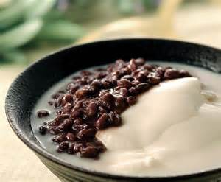
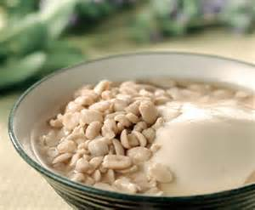
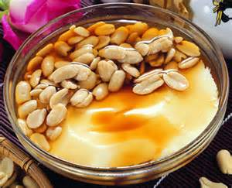
Douhua
Bean curd, bean curd full name, also known as bean curd or frozen Is formed from yellow milk solidified Chinese food

Slide 7
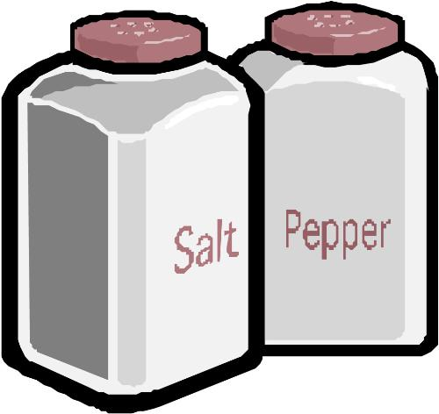
Prepare materials
Douhua the material：
Soybean 300 grams (Please use a non-genetically modified soybeans), 10 bowls of water (about 2200cc), tofu plaster 5-7 grams
40 grams of sweet potato flour
half a bowl of cold water
the material Tong Shui ：
Sugar bowl, 5 bowls of water
ginger 6

Slide 8
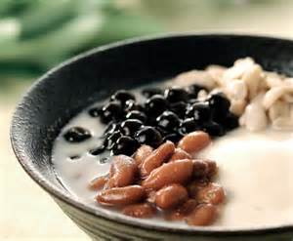
Douhua practice
1. Soybean soak overnight first, then Soybean and 10 times with the blender bowl of water smashed after breaking boil then filtered dregs, it becomes soymilk
2. Take a width of 30 cm diameter and a height of about 30 cm above the round pot into tofu plaster, sweet potato powder, stir together the bowl of water
3. The filtered good soymilk from a height Round down into the pot, then stir to forgo Mix until 10 minutes into the Douhua after
coagulation The top of the foam can be
scraped off with a spoon
4. Tong Shui production: just all Tong Shui Material together boil. Can also be used Bean soup or bean soup, and so on Tong
Shui substitute

Slide 9
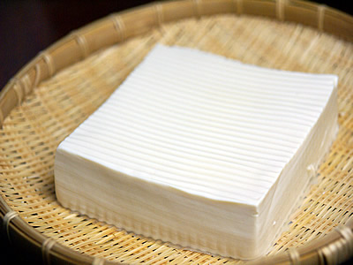
Tofu practice
The Douhua wrapped with cotton flat top with heavy objects up to dehydration forming, after a period of time to become tofu, soaked with cold
water in the refrigerator
you can save on the
number of days

Slide 10
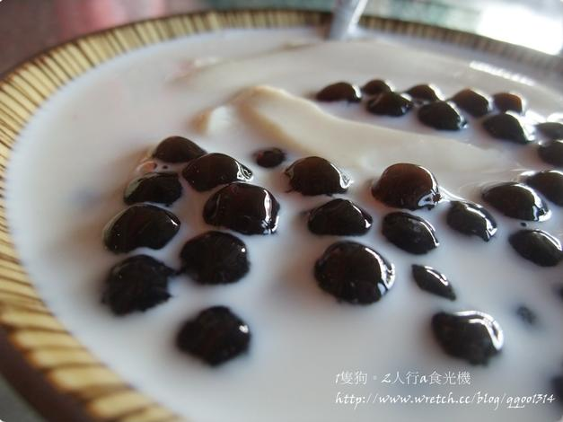
Self-made traditional Douhua
There are three practice Douhua：
(1). With bean pollen, which is readily available powder, most likely to produce (inside there with a little gypsum powder)
(2). Consumption of gypsum
powder is usually too sweet
potato flour or cornstarch
added, a little difficult, and
plaster More likely to eat a
lot of pink stones
(3). Is a halogen salt is a
natural Crystals, looks a bit
like But salt particles bigger than the salt

Slide 11
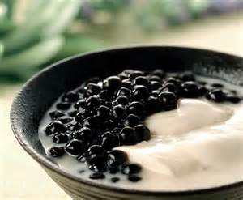
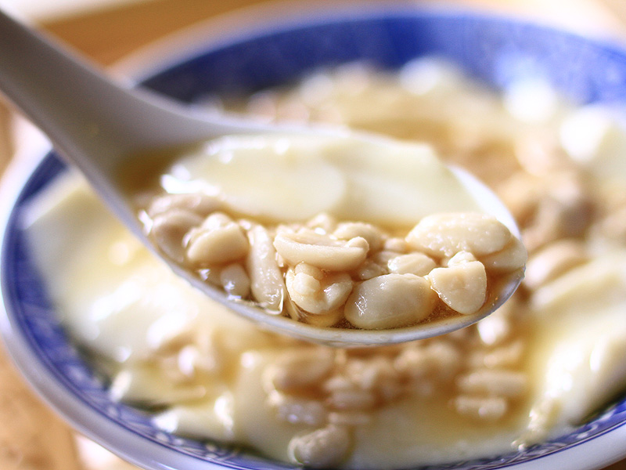
Mung bean Douhua
Pink circle Douhua
Red bean Douhua
Peanut Douhua

Slide 12
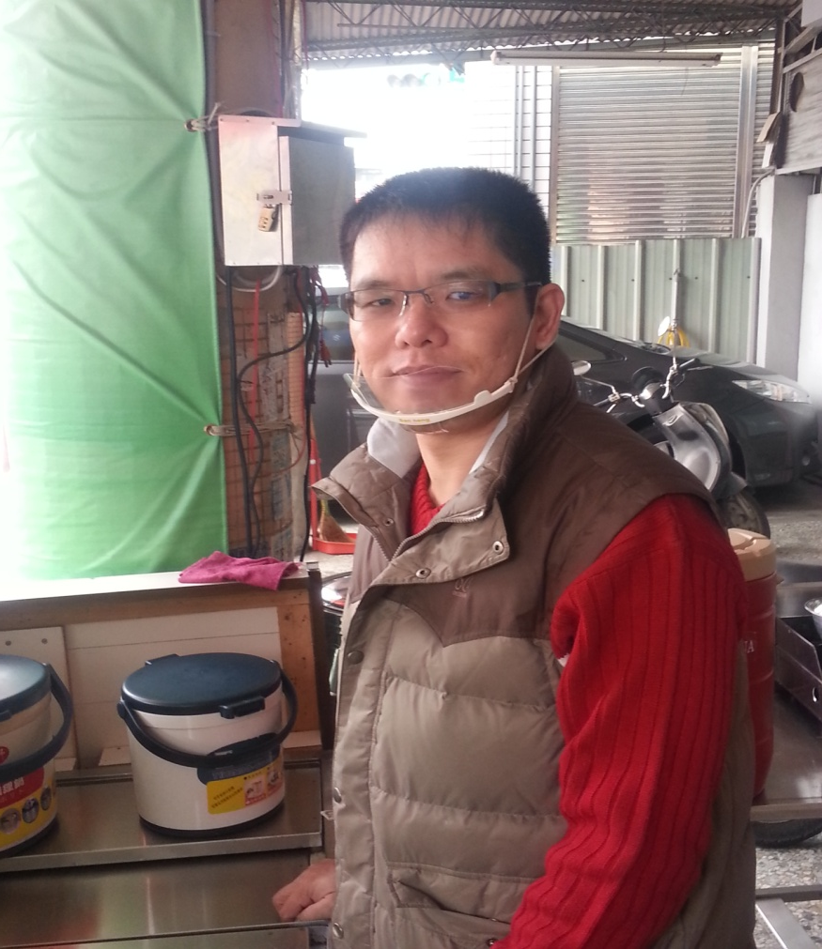
Uncle

