Slide 1
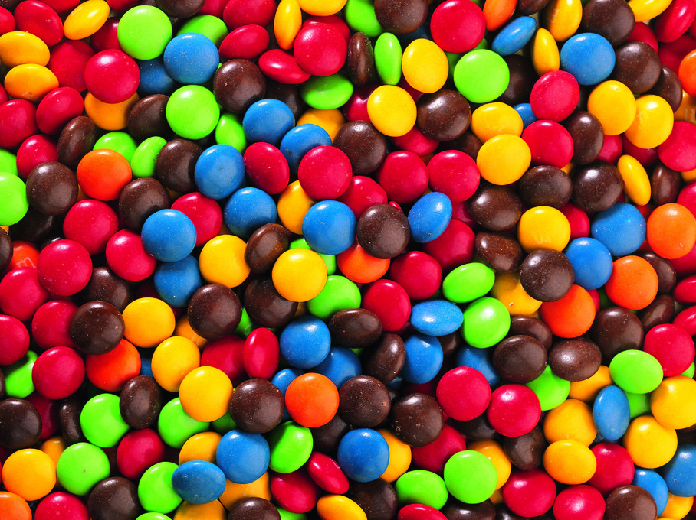
Features Candy States Exhibition
Speaker：Irene、Vivian

Slide 2
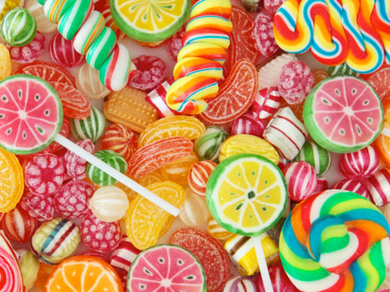
Who Invented candy
?
After the sugar history of mankind can be traced back 10,000 years ago, the invention is not in Europe, nor America, but not China, but New Guinea, the people of this region with seven years of sugar, sugar technology was passed in Egypt until 500 years ago, the Arabs brought to Europe, and by the Spanish colonial everywhere, spread all over the world.
Generally considered to be the oldest candy maltose, honey, sugar-coated almonds wrapped inside out sugar candy is also the ancestors of the family-level role.
Notes:
傳說「士的」糖(SugarStick) 是由一位希望見證耶穌的糖果商人發明的。「士的」糖是硬的，正如耶穌基督是萬古磐石；「Ｊ」形的糖身，代表耶穌(Jesus)第一個字母或牧羊人的杖；白 色代表耶穌的純潔；紅色的紋代表基督為我們的罪流血，另外三條較細小的紅紋，是祂為我們所受的鞭痕；有些「士的」糖有綠色的紋，這代表耶穌是神給我們的禮 物。「士的」糖是用薄荷造的，因薄荷是牛膝草類（耶穌釘在十字架上時，兵丁以海絨浸了醋，綁在牛膝草上，送到祂唇邊），而且牛膝草代表潔淨和犧牲。耶穌是 純潔的羔羊，祂來是為世人的罪犧牲，捨身流血為我們贖罪。手杖上端捲曲狀使它像牧羊人的枴杖，倒過來看，手杖形似字母"J"，耶穌名字的第一個字母。但很 多象徵及意義現今並不太廣為人知。

Slide 3
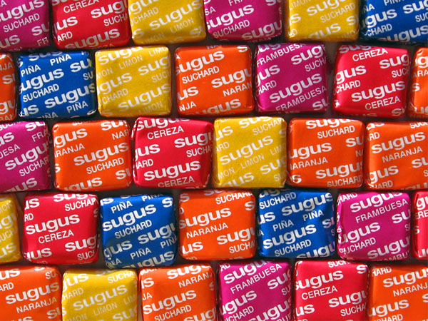
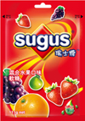
Sugus
Switzerland
Sugus sugar originated in Europe, Switzerland, by the Swiss businessman Philippe Suchard confectionery invention in 1932, the production and the market, are still popular in Europe.
To April 2005, the American company acquired Sugus Switzerland Wrigley sugar from a merger, rather Sugus Switzerland Wrigley's sugar become a favored candy brands.
Price: NT 105 / Pack
(I)Packaging

Slide 4
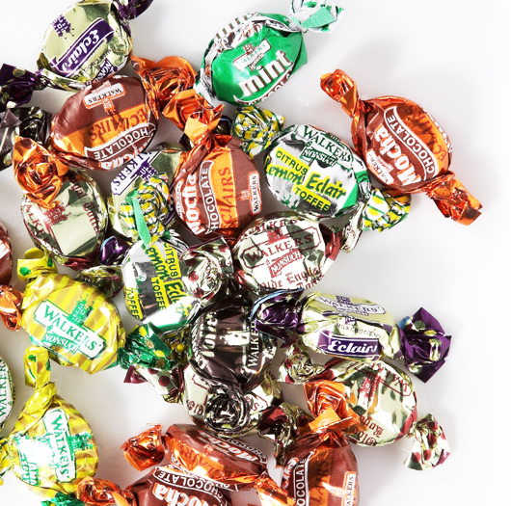
Walkers’ Toffee
Toffee, English Toffee mean Western candy, a kind of sugar is also referred to, with brown sugar or molasses and butter made ​​of hard and difficult to chew sugar.
125 years ago, the Everton players after training and competition in a candy shop to gather to chat and eat dessert, especially the toffee, over time, "toffee" has become synonymous with the team.
Price: NT 99 / Pack

Slide 5
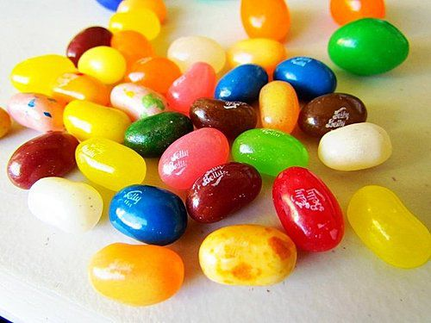
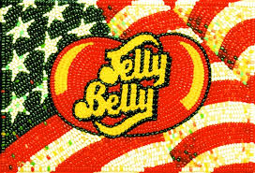
Jelly Belly
Unlike Jelly Belly jelly beans, is the first integrated into the natural flavor of jelly beans candy hearts. They use natural juice extracted from the traditional handmade workmanship, the production process without any chemical additives, are plant preparations.
In 1983, America's first female astronaut Sally Ride into space, in the same trip mission Jelly Bean also became the first astronaut into space accompanied traveled jelly beans.
Even former U.S. President Ronald Reagan used to entertain all love a good thing, also known as "Jelly Beans."
Price: NT 99 / Pack
Jelly Belly classic LOGO

Slide 6
JellyBelly thousand kinds of tastes

Slide 7
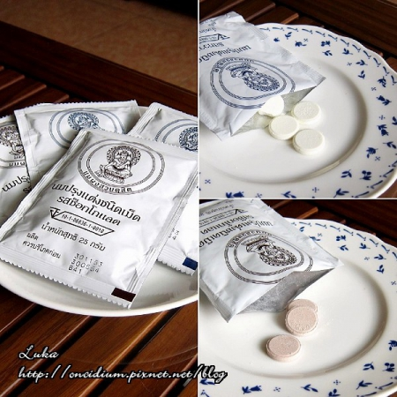
Royal Thai Milk Tablets
Legend IX King of Thailand Bhumibol Adulyadej (BhumibolAdulyadej) in order to help farmers to promote milk (also said to be from a royal ranch), and a low price to sell, so that poor children can also be nutritional supplement milk tablets.
Is a network spread to Thailand with one hand ceremony will buy
Price: NT 280/10 pack
Chocolate taste / flavor

Slide 8
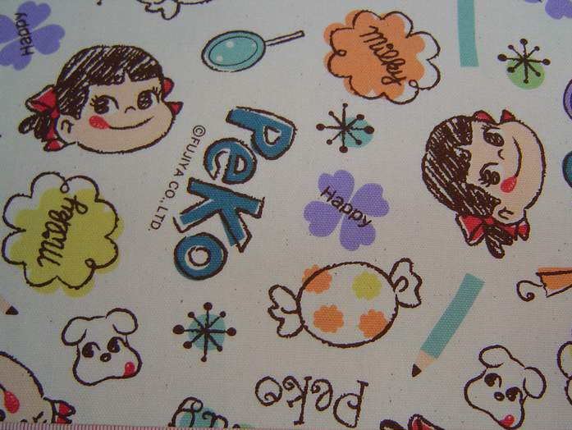
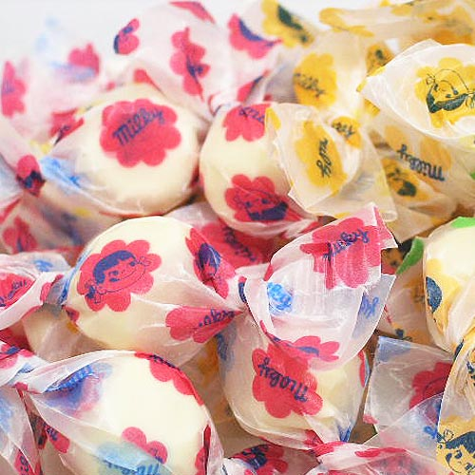
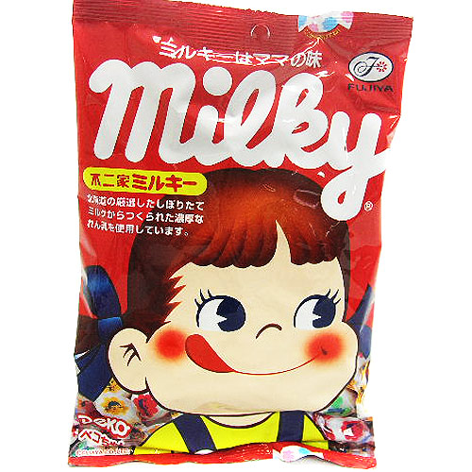
Fujiya Peko Milk Sugar Bags
Fujiya "PEKO", was born in AD 1950, the first time the consumer is faced with bags of sugar in milk packaging market, so there is "milk sugar dolls" nickname. AD 1952 when Japan sold, the name of "mother's milk is the taste of sugar" advertising slogan, caused a whirlwind in Japan.
Price: NT69 /package
Milk bags of candy
Milk bags of candy packaging

Slide 9
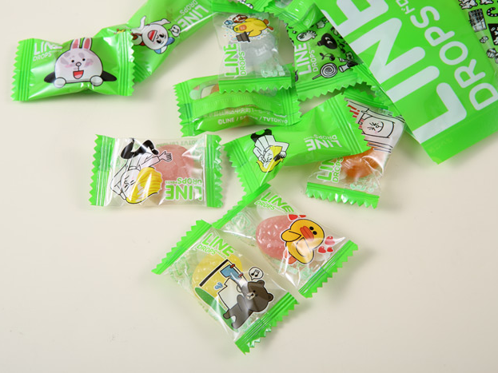
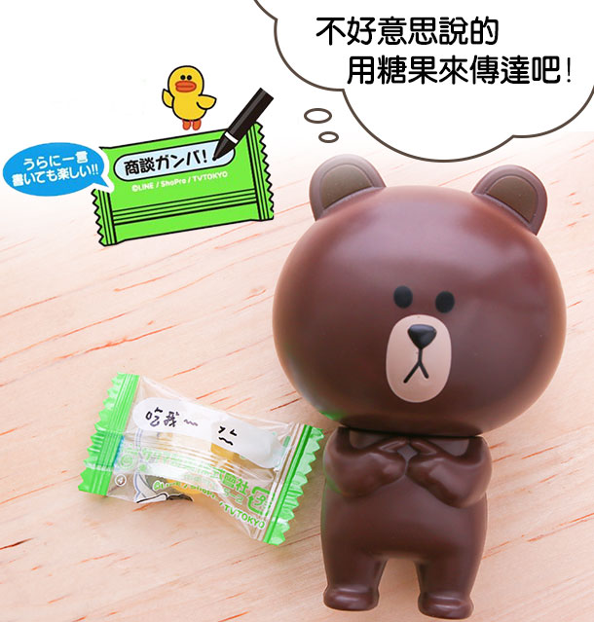
Sakuma LINE Integrated Fruit Sugar
Mobile Ultra ram LINE textures, this time with the big brands Sakuma cooperation, a pack of eight kinds of fruit flavors and enjoy people have bread on outsourcing, big bear, rabbit, also wrote a message that you want to pass the package above.
Price: NT 138 / two pack
Packaging can write dare say

Slide 10
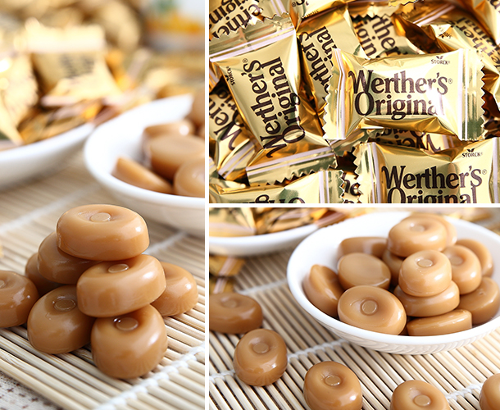
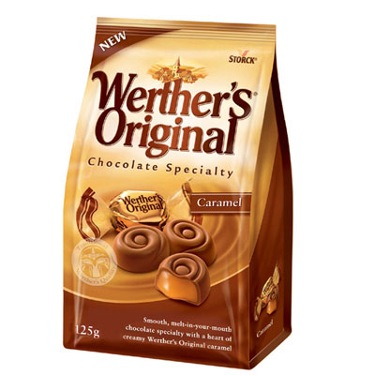
Waite authentic sugar
Early 20th century, in a small town called Waite, there was a man named Gustav Nebel candy shop, he used pure butter and fresh cream, sugar, brown sugar and a pinch of salt, with a kind of simmered best to eat baked milk sugar, cream sugar because it is so delicious, so they put this sugar Waite named authentic butterscotch, to commemorate his hometown.
Price: NT 89 / a pack
Waite sugar packaging

Slide 11
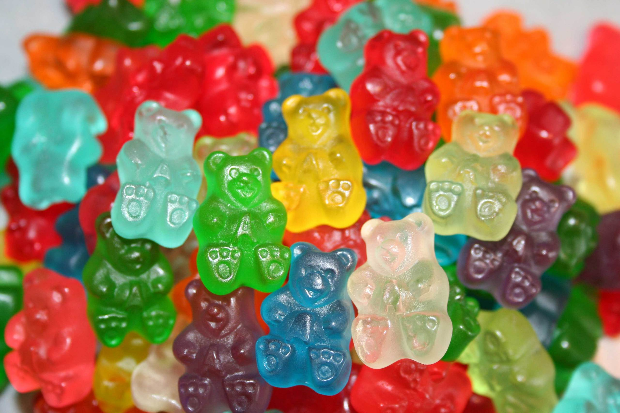
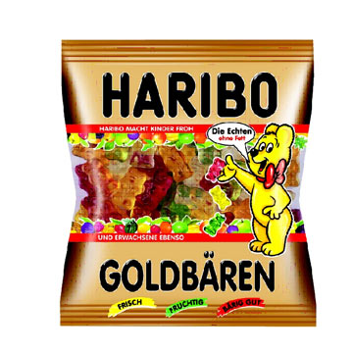
Haribo Gummy Bear
Gummy Bear is one of Germany's Haribo sweets a specialized production company produces a range of products, the company has a long history, founded in 1920 by the founder Hans Riegel in Bonn, and therefore, Mr. Riegel take "HansRiegel in Bonn beginning with the letter "of the combined company's name which is" Haribo "! Gummy Bear is invented by Mr. Riegel in 1922, and thus production.
Perhaps you have a question, how no blue bear it? According to Haribo's answer, first, each color and flavor gummy bears are derived from natural fruit, not the use of artificial coloring manufacturing. Secondly, because in all the natural plant, there is no natural blue can be grown out of the plant, so there is no blue gummy bears exist.
Price: NT 99 / Pack
Bear candy packaging

Slide 12
Thankyou for your listen

