Slide 1
BEER IS LIFE

Slide 2
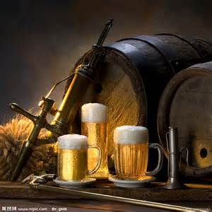
History of beer
Beer , also known as ale, liquid bread, is one of the world's oldest and most widely spread range of alcoholic beverages, beer is the world's oldest beverages.

Slide 3
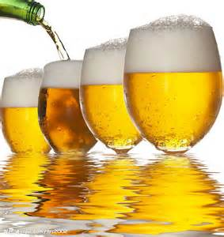
The origin of beer
History of beer is said to date back to 4000-8000 years BC. Dating back about 5,000 years ago in Mesopotamia Sumerian has begun manufacturing.

Slide 4
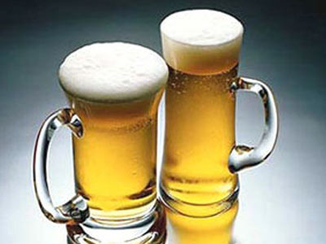
Manufacturing methods
Sumerian cuneiform inscribed on clay depicting the beer making process at that time. The beer was prepared by dry after the wheat ground into flour, then add water to make bread and then smash through natural fermentation.

Slide 5
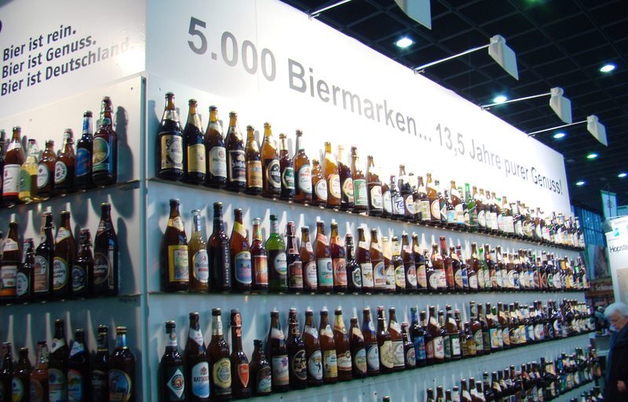
Germany has more than five thousand kinds of wine.

Slide 6
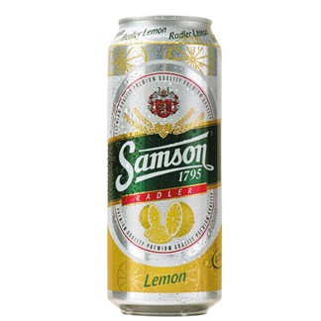
Samson Fruit Beer - Lemon
◆ Two centuries of winemaking heritage craft.
◆From the birthplace of Czech beer.
◆ Origin: Austria
◆Alcohol: 2.2 degrees

Slide 7
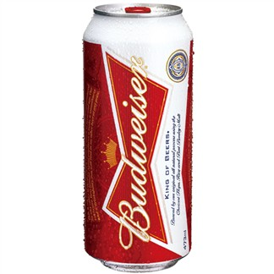
Budweiser
◆ Budweiser selected Canadian wheat and malt processing through the malting plant.
◆ Origin: United States
◆ Alcohol : 4 degrees

Slide 8
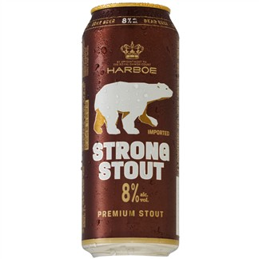
Bear Beer
◆ Configure the brand logo and the Arctic polar bear totem, while presenting a combination of traditional German culture and new technology.
◆ Origin: Germany
◆ Alcohol: 8 degrees

Slide 9
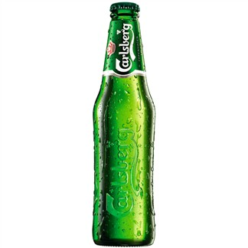
Carlsberg Beer
◆ Certainly by the Danish royal family, are still designated a state banquet Danish beer. World-renowned 150 countries, is the world's fourth largest winery.
◆ Origin: Denmark
◆ Alcohol: 5 degrees

Slide 10
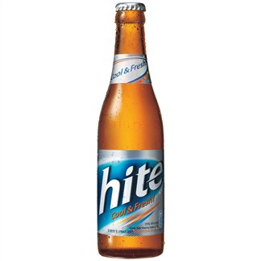
Hite
◆ The highest market share in South Korea's best-known beer brands.
◆ Origin: South Korea
◆ Alcohol: 4.5 degrees

Slide 11
Group member
Eva
Julie
Irene

