Slide 1
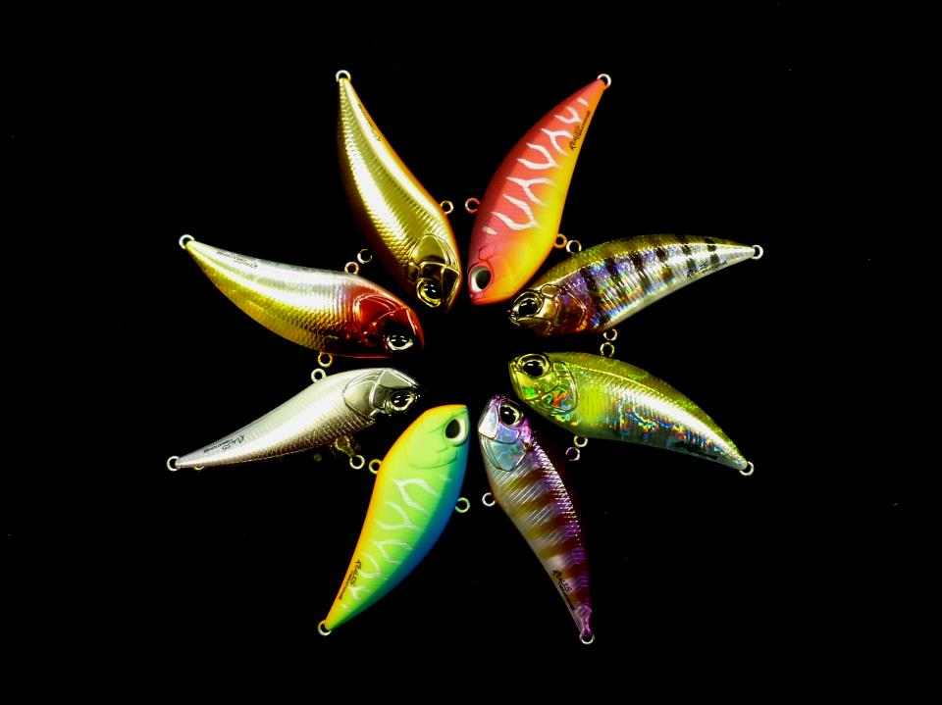
LURES
102學年修平會展期末成果展
簡報人員: Una
Fang
Eating
Jun

Slide 2
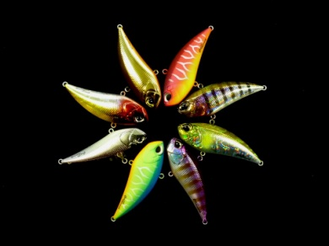
Who is he?
RAPALA

Slide 3
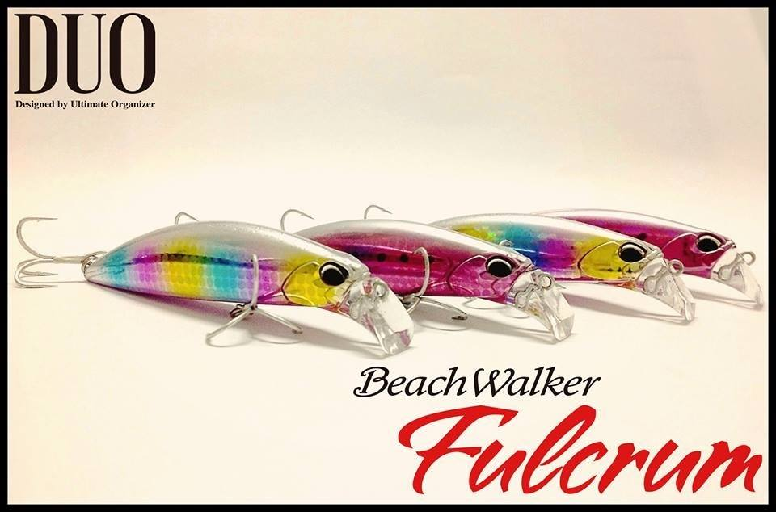
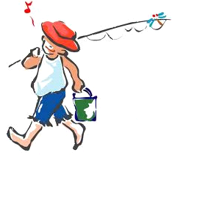
What is Lure?
Notes:
擬餌＝路亞
最早其實是由天才小釣手一書，在翻譯LURE成中文時，翻譯者直接音譯過來的
路亞是甚麼?路亞兩字來自英文Fishing lure的"Lure"一字， 泛指誘惑、引誘、誘餌之意；也就是說，路亞釣法，是用各類的假餌來 吸引魚類的注意，讓魚誤認那是美味的食物而一口咬下。

Slide 4
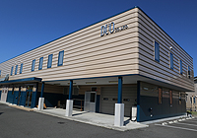
Company profile
Company name | DUO CO.,LTD
Established | August,1995
President | Masahiro Adachi
Major Products | Planning and development, Manufacturing and sale of the fishing tackles.

Slide 5
Sales Area
DUO is the beginning of the establishment of specially crafted bass fishing lure, it has been proposed many different baits and large-scale markets.

Slide 6
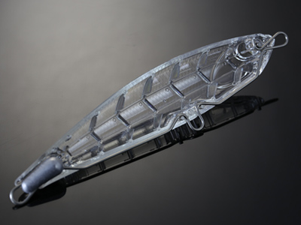
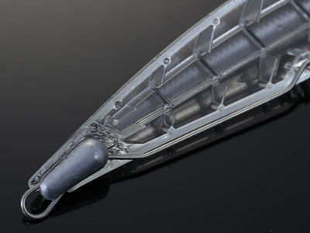
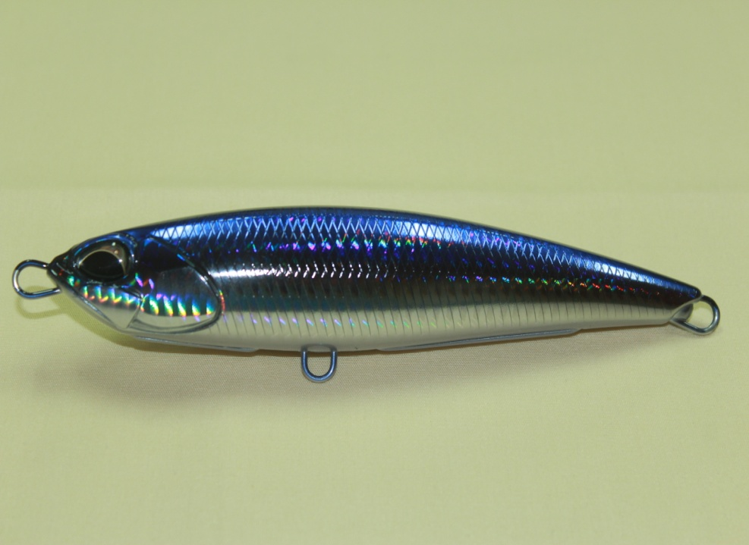
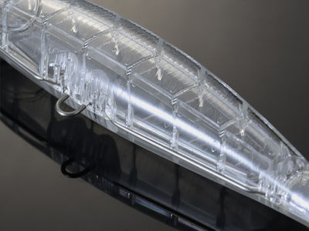
Products
Rough Trail Aomasa 148
Length 148mm
Weight 38.0g

Slide 7
Video

Slide 8
THE END
Thank you for listening.

